Slide 1

SE3SL11
“The course with no name…”
Pat Parslow
p.parslow@reading.ac.uk
Room 129
Pat Parslow, Room 129, P.Parslow@reading.ac.uk

Slide 2
SE3SL11
Courseworks – 7 components
1 3 brief abstracts of articles on current technology stories (5%) 23/10/15
2 Critique a selection of peer-produced abstracts (10%) 20/11/15
3 An Academic Paper on issues related to the social impact of technology (20%) 20/11/15
4 A group based report identifying, analyzing and critiquing issues related to SLEP (20%) 11/12/15
5 A group based video presentation summarizing coursework 4 conclusions (20%) 27/11/15
6 A blackboard based multiple choice test on assessing legal content (15%) 30/10/15
7 Reflective piece (10%) 15/01/16
Pat Parslow, Room 129, P.Parslow@reading.ac.uk

Slide 3

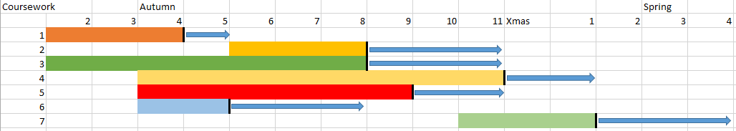
SE3SL11 coursework
Deadline
Feedback window
Pat Parslow, Room 129, P.Parslow@reading.ac.uk

Slide 4
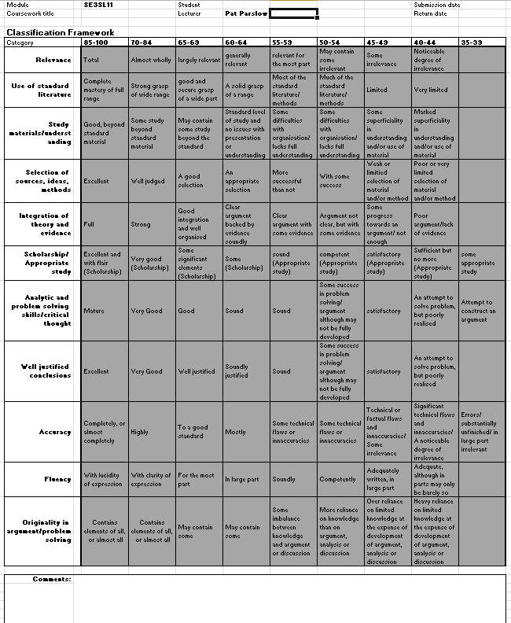

Don’t Forget
– self
assessments
Pat Parslow, Room 129, P.Parslow@reading.ac.uk

Slide 5
Courseworks 1 & 2
Abstracts & Critique (15%)
  3 abstracts – 17th Oct `14
  Critique – 14th Nov `14
Pat Parslow, Room 129, P.Parslow@reading.ac.uk

Slide 6
Coursework 1
Professional
Social
Legal
Ethical
- Things you need to consider
Pat Parslow, Room 129, P.Parslow@reading.ac.uk

Slide 7
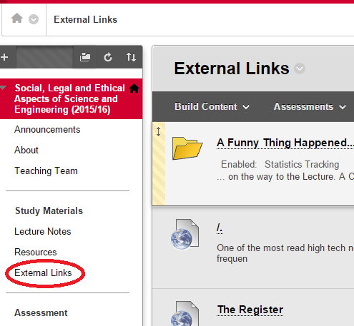
Coursework 1
On Blackboard…
Pat Parslow, Room 129, P.Parslow@reading.ac.uk

Slide 8
Coursework 1
Web Links
A mixture of web resources
Interesting
Informative
Worrying
Educational
Pat Parslow, Room 129, P.Parslow@reading.ac.uk

Slide 9
Coursework 1
Stage 1
Using the materials in the Web Links folder, or other topical stories about technology (available online, in English):
Write an abstract (1 or 2 paragraphs, about 250 words) for each of three stories
Pat Parslow, Room 129, P.Parslow@reading.ac.uk

Slide 10
Coursework 1
What should you write about?
For each of the 3 stories you pick:
Highlight any Social, Legal, Ethical and Professional issues
Each abstract should be plain text in its own document (.txt)
Name each file <id>_N.txt
Where <id> is your Uni username.
e.g. jb975312_1.txt jb975312_2.txt jb975312_3.txt
Zip your 3 abstracts in to 1 archive and submit them
Pat Parslow, Room 129, P.Parslow@reading.ac.uk

Slide 11
Marking coursework 1
Marks are awarded for correctly submitting:
The right number of abstracts
In the right format
With the right file naming convention
The requirements are not hard – but read them, they are specific. Failure to comply increases my workload and reduces your mark.
Pat Parslow, Room 129, P.Parslow@reading.ac.uk

Slide 12
Coursework 2
You will then receive 3 randomly selected abstracts.
  There may be a short delay while ~200 abstracts are quality checked and assigned!
  I will get these to you by week 3
For the 20th Nov 2016 deadline you must:
Write a discussion paper critiquing the abstracts you received
Pat Parslow, Room 129, P.Parslow@reading.ac.uk

Slide 13
Coursework 2
Critique the 3 abstracts (deadline 20 Nov 2015)
  Do they draw out salient points?
  Do they represent general, minority or extreme views?
  Do they frame the issues well?
This should be a report (word limit 2000), including a management summary of the analysis, and should use the School style guide. The file must be named <id>_Critique and must be submitted as a .doc or .docx format file
  (Where <id> is your Uni username)
  Consider – how do you analyse texts? What criteria should you use?
Pat Parslow, Room 129, P.Parslow@reading.ac.uk

Slide 14
Coursework 3
Discussion paper (Also 20th Nov 2015 deadline):
Write a paper, using the style guide, which discusses one of the following topics:
Professionalism and the Internet
Social Media should be regulated
Government censorship of the Web
Drones, driverless cars and robotics
  This should be a report, including an abstract, and should use the School style guide. The file should be named <id>_Discuss and must be submitted as a .doc or .docx
  (Where <id> is your Uni username)
Pat Parslow, Room 129, P.Parslow@reading.ac.uk

Slide 15
Minutiae
Late work will be penalised as usual.
Marks will be deducted if the School style guide is not followed (treat this as an academic report)
Additionally: 2000 word limit plus abstract (250 words max) and references
Pat Parslow, Room 129, P.Parslow@reading.ac.uk

Slide 16
Courseworks 4 & 5
This will be a group project
You will, as a group, choose one film or game which raises questions about social, legal, ethical and professional issues relating to technology.
Email me this, so I can check it is suitable, by the end of week 3.
Pat Parslow, Room 129, P.Parslow@reading.ac.uk

Slide 17
Courseworks 4 & 5
You will then, as a group, select one film and:
4 Produce a report analysing the film in terms of SLEPA (11 Dec 2015)
5 Produce a self-running presentation e.g. short film, 5 to 10mins in length (27 Nov 2015)
Pat Parslow, Room 129, P.Parslow@reading.ac.uk

Slide 18
Minutiae
Late work will be penalised as usual.
Marks will be deducted if the School style guide is not followed (treat this as an academic report)
Additionally: 4000 word limit plus abstract (250 words max) and references
Pat Parslow, Room 129, P.Parslow@reading.ac.uk

Slide 19
Marking
First class marks (70% plus) will only be given to outstanding and excellent work, evidenced against criteria including:
  Relevance;
  Evidence of study beyond the standard material;
  Selection of sources and ideas brought to bear with insight;
  Well justified and full conclusions;
  Accurate;
  Fluently written;
Pat Parslow, Room 129, P.Parslow@reading.ac.uk

Slide 20
Marking
Second class marks (60-70) will be given for good to very good work based on a sound to clear understanding of the issue.
Second class marks (50-60) will be given for competent to sound work addressing the issue.
Third class marks (40-50) will be given for a reasonable attempt to address issue using the more obvious standard approaches.
Work below honours standard will attract marks if there is an indication of effort and study.
Pat Parslow, Room 129, P.Parslow@reading.ac.uk

Slide 21
Coursework 6
Online test:
This will be short, and will test you on your knowledge of Legal aspects.
It will be an open-book, online test.
It is semi-automatically marked – you are expected to include the references you use for all your answers and justify their choice in the last part.
Pat Parslow, Room 129, P.Parslow@reading.ac.uk

Slide 22
Coursework 7
Reflections
  Do not submit this until you have had feedback on the group report.
  Structure the reflective report
  Submit as a .doc or .docx
  Deadline 15 Jan 2016 – spring term.
  Read this advice http://www.uefap.com/writing/genre/reflect.htm
Pat Parslow, Room 127, P.Parslow@reading.ac.uk

